Slide 1
Links, command line, Understanding stdin, stderr and stdout in Linux

Slide 2
Hard link and soft link
Hard link Command Syntax
$ ln [original filename] [link name]
Soft link Command Syntax
$ ln -s [original filename] [link name]

Slide 3
command line
The Linux command line is a text interface to your computer.
Also known as shell, terminal, console, command prompts and many others, is a computer program intended to interpret commands.
Allows users to execute commands by manually typing at the terminal, or has the ability to automatically execute commands which were programmed in “Shell Scripts”.

Slide 4
A bit of history
The Bourne Shell (sh) was originally developed by Stephen Bourne while working at Bell Labs.
Released in 1979 in the Version 7 Unix release distributed to colleges and universities.
The Bourne Again Shell (bash) was written as a free and open source replacement for the Bourne Shell.
Given the open nature of Bash, over time it has been adopted as the default shell on most Linux systems.

Slide 5
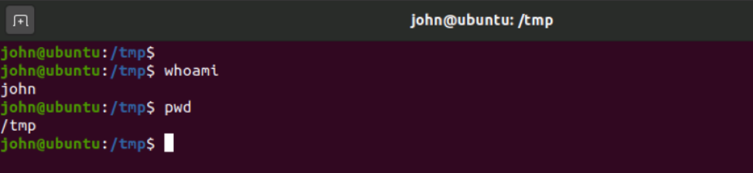
First look at the command line
When a terminal is open, it presents you with a prompt.
Let's analyze the screenshot above:
Line 1: The shell prompt, it is composed by username@hostname:location$
Username: our username is called “john”
Hostname: The name of the system we are logged on
Location: the working directory we are in
$: Delimits the end of prompt
After the $ sign, we can type a command and press Enter for this command to be executed.

Slide 6
After the $ sign, we can type a command and press Enter for this command to be executed.
Line 2: After the prompt, we have typed the command whoami which stands for “who am i“ and pressed [Enter] on the keyboard.
Line 3: Shows us the result of the whoami command we have previously issued, also known as command output. This command simply prints out the username of the current user.
Line 4: Shows an example of another basic command called pwd which stands for print working directory.
Line 5: As seen before, this line shows the result of the command previously issued. /tmp is our working directory.
Line 6: Presents us with a new prompt, and waits for us to type a new command.

Slide 7
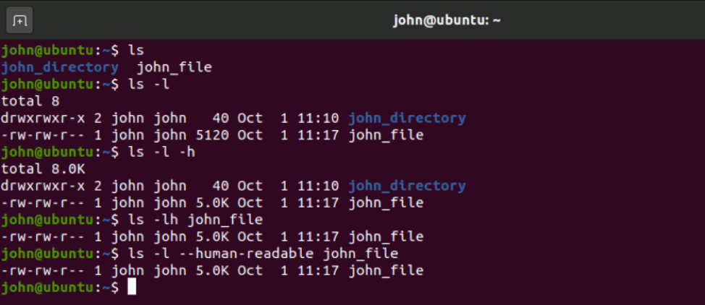
Command syntax
Commands can be run by themselves, or can accept arguments to alter their behavior.
A typical syntax can look similar to this:
command [-argument] [--long-argument] file
Example:

Slide 8
At first, we entered the command ls which stands for list. By default this command will print the content of the current directory.
Secondly, we have added an argument to ls by typing a space and -l. This argument is changing the output format of ls and stands for “long listing format”.
Next, we have added another argument -h which stands for “human”, this argument instructs the ls command to print file size in a human readable format.
Later on, we have combined two arguments, -l and -h in -lh which gives us the same result and we have given a file name to “ls”. The result shows us only the file passed as the last argument.
As a final example, we have replaced the short argument -h with its equivalent long argument form --human-readable. As you can see, the command’s output didn’t change.

Slide 9
It is case sensitive
In a Linux shell, commands, files and directory names are case sensitive meaning that typing pwd will print the current working directory and typing PWD will return an error similar to -bash: PWD: command not found.
Nearly every Linux command supports --help argument
During your journey with the CLI, you will often wonder “what argument do I need to do X?” The answer is just a --help away

Slide 10
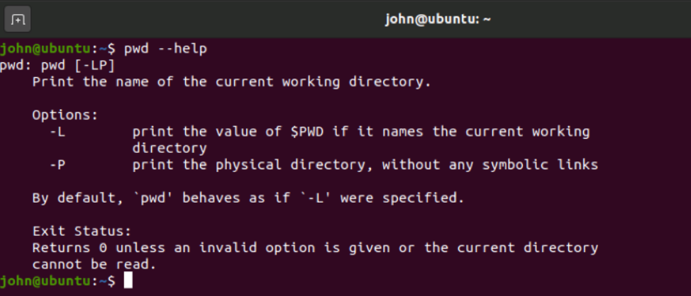

Slide 11
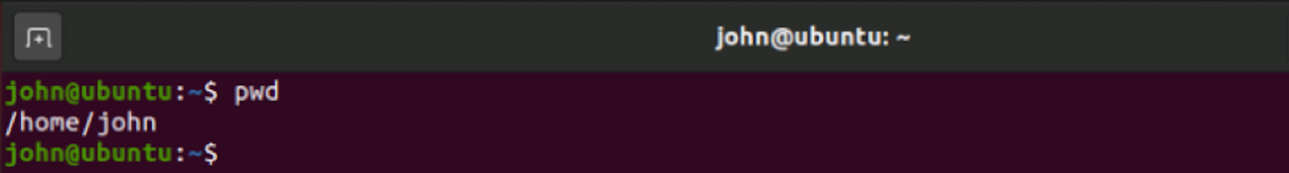
Basic commands
pwd
As we have seen before, pwd will simply print out the current working directory.

Slide 12
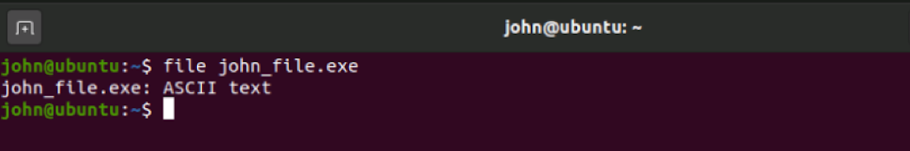
ls
We have already used this command before, and we already know what it does. It lists the content of a given directory. The peculiarity of this command is that it supports a wide range of arguments.
file
This command will show the kind of a file passed as argument.
In the example below, we see john_file with a “.exe” extension, the file command outputs the real file kind, in this case a simple text file.

Slide 13
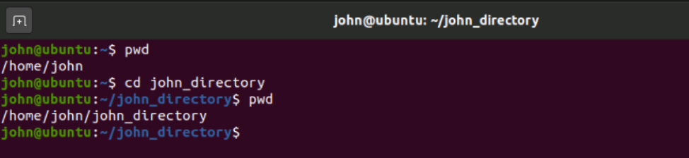
cat
The cat command will print out the content of a text file given as argument.
cd
The cd command, which stands for Change Directory, will change your working directory to the one passed as argument.

Slide 14
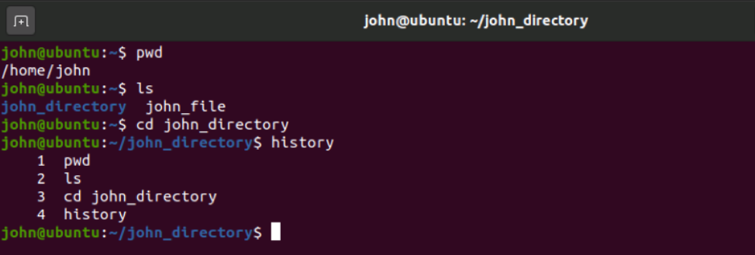
clear
After some time using the terminal, your screen will look messy and confusing.
To clear the screen and start all over, type the clear command.
history
The history command, will show an historical list of commands that were entered in the terminal session.

Slide 15
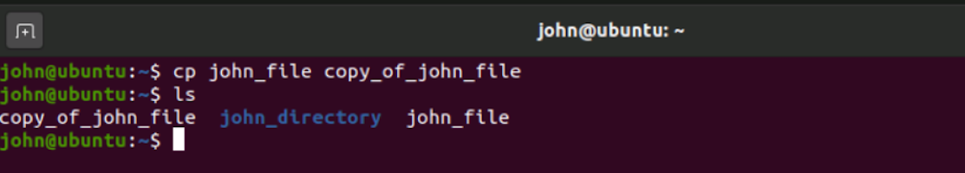
cp
The cp command, which stands for copy, is used to create a copy of a file/directory.
To create a copy of john_file and call our copy copy_of_john_file we will use the cp command.

Slide 16
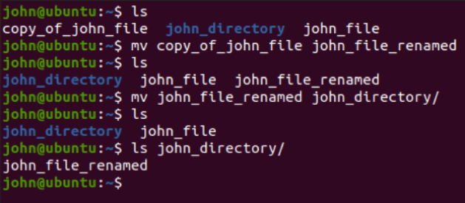
mv
The mv command, which stands for move, moves a file/folder to a new location, or renames it.
To rename the file copy_of_john_file to john_file_renamed we will use the mv.
To move the file john_file_renamed inside john_directory we will still use mv.

Slide 17
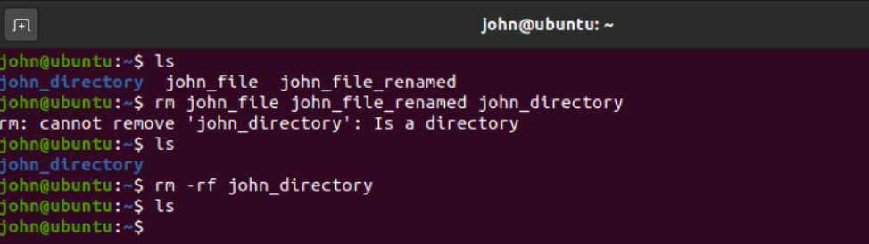
rm
Our last but not least command for today’s article is rm, which stands for remove.
It is used to delete files, but can delete directories as well if instructed to do so.

Slide 18
Understanding stdin, stderr and stdout in Linux
There is a decent chance that if you have used Linux operating systems then you might have encountered the three famous data streams known as stdin, stderr and stdout. All these are different in their functions and have their own uses but one thing common between all three of them is that they are data streams that bash creates.
Let’s understand more about what data streams actually mean and how they are beneficial. In terms of computing, a data stream is something that gives us the ability to transfer data from a source to an outflow and vice versa. The source and the outflow are the two end points of the data stream. It might be interesting for you to know that whatever command you are running in your Linux terminal, it will either be at one of these end points.

Slide 19
Now we know a little about the data streams, let’s know more about the three famous data streams.
stdin − It stands for standard input, and is used for taking text as an input.
stdout − It stands for standard output, and is used to text output of any command you type in the terminal, and then that output is stored in the stdout stream.
stderr − It stands for standard error. It is invoked whenever a command faces an error, then that error message gets stored in this data stream.
It should be noted that in Linux all these streams are treated as if they were files. Also, linux assigns unique values to each of these data streams.
0 = stdin
1 = stdout
2 = stderr

Slide 20
Command
read
he read command can be used with and without arguments.
If we pass the read command without any argument, it will take a line as user input and store it in a built-in variable 'REPLY'. Execute the command as:
read
The above command will ask for the user input. Type the user input and press ENTER key to save it. To display the entered content, execute the command as:
echo $REPLY
The above command will display the stored input from the 'REPLY' variable.

Slide 21


Slide 22
Specify the variables to store the values
We can specify the variables to store the input. If the number of specified variables is lower than the entered words, it will store all the remaining words in the last variable by default. Consider the below command:
read var1 var2 var3
Javatpoint is the best portal to learn Technologies // Entered text
The above command will store the 'Javatpoint' in 'var1', 'is' in 'var2', and all remaining words in 'var3'. To verify the values, execute the below command:
echo "[$var1] [$var2] [$var3]"

Slide 23
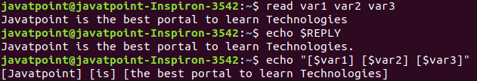
The above command will display the variable values. Consider the below output:

Slide 24
stdout is shown below −
ls -ltr
Output
immukul@192 Downloads % ls -ltr
total 1085456
drwxr-xr-x@ 13 immukul staff 416 Dec 7 2019 source-code-pro-release
-rw-r--r--@ 1 immukul staff 350337 Dec 22 2019 messi.jpg
-rw-r--r--@ 1 immukul staff 5953321 Dec 22 2019 927225.png
-rw-r--r--@ 1 immukul staff 601852 Dec 22 2019 238870.jpg
.
.

Slide 25
stderr is shown below −
Command
ls -ltr printit
The above command is invalid as I don’t have any directory named printit and it will generate an error message that will be sent to stderr and then the terminal will print it.
Output
immukul@192 Downloads % ls -ltr printit
ls: printit: No such file or directory

